Slide 1








«LeaderZ»
Academy

Slide 2

«LeaderZ»
- a new format of comprehensive development of children and adolescents in the form of educational courses and courses of additional education.

Slide 3

Welcome to our Academy
LeaderZ would develop next directions:
PORTFOLIO FOR ADMISSION TO TOP UNIVERSITIES
SOFT SKILLS
PREPARATION FOR NATIONAL EXAMS
PREPARATION FOR INTERNATIONAL EXAMS
A practice-oriented school for the all-round development of children and adolescents in three areas: leadership, acting and public speaking.
Courses to prepare for the national exams. We have prepared an intensive program of 3 months, during which your children can get basic knowledge and eliminate gaps in knowledge.
Preparation for international exams IELTS, SAT, NUFYPET, APTIS, TOEFL with native speakers in online and offline format of your choice.
Providing information about the latest competitions, festivals; participation in various events with certificates, assistance in competent filling out documents.

Slide 4



PUBLIC SPEAKING
School of leaders «LeaderZ»
LEADERSHIP

Slide 5




ACTING
CAREER GUIDANCE
SOCIAL WORK AND VOLUNTEERING
FINANCIAL LITERACY

Slide 6


OUR FEATURES:
- Studying in 3 languages
- Summer camp
- Teamwork, picnics
- Young teaching staff
- 20 % of theory and 80 % of practice

Slide 7
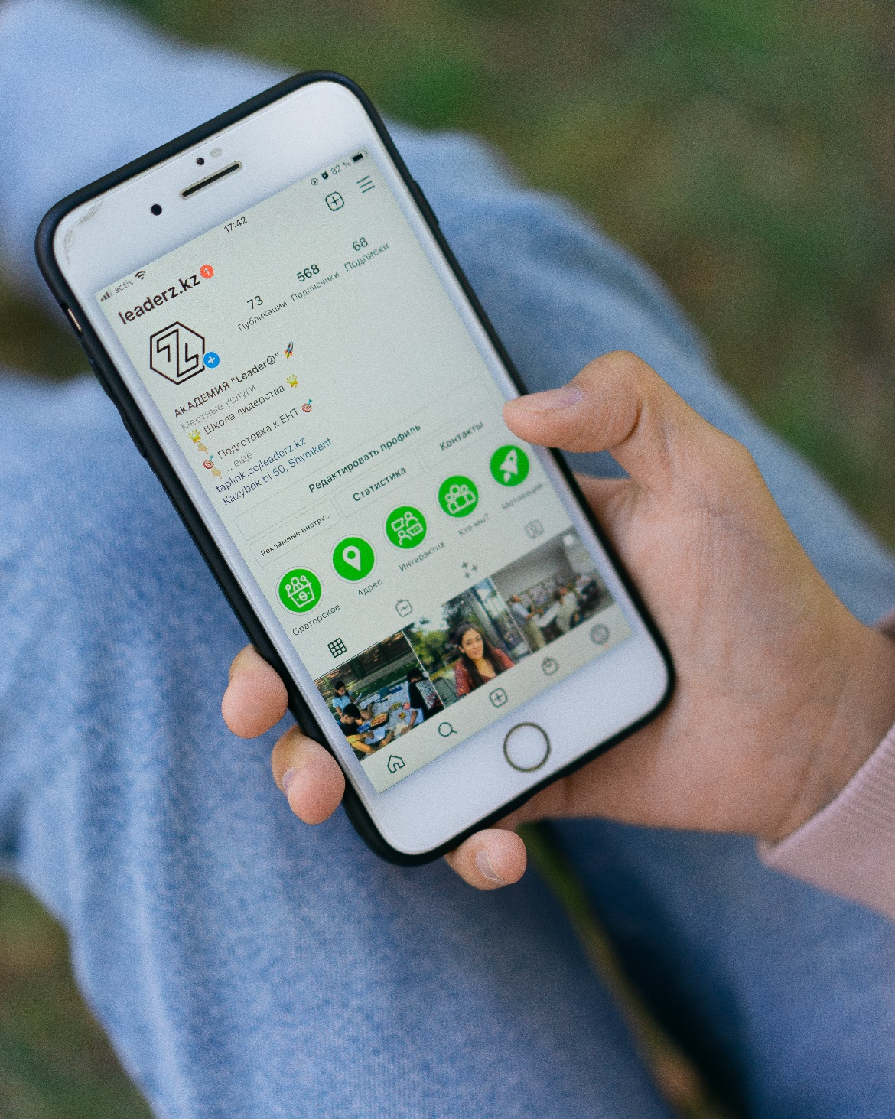

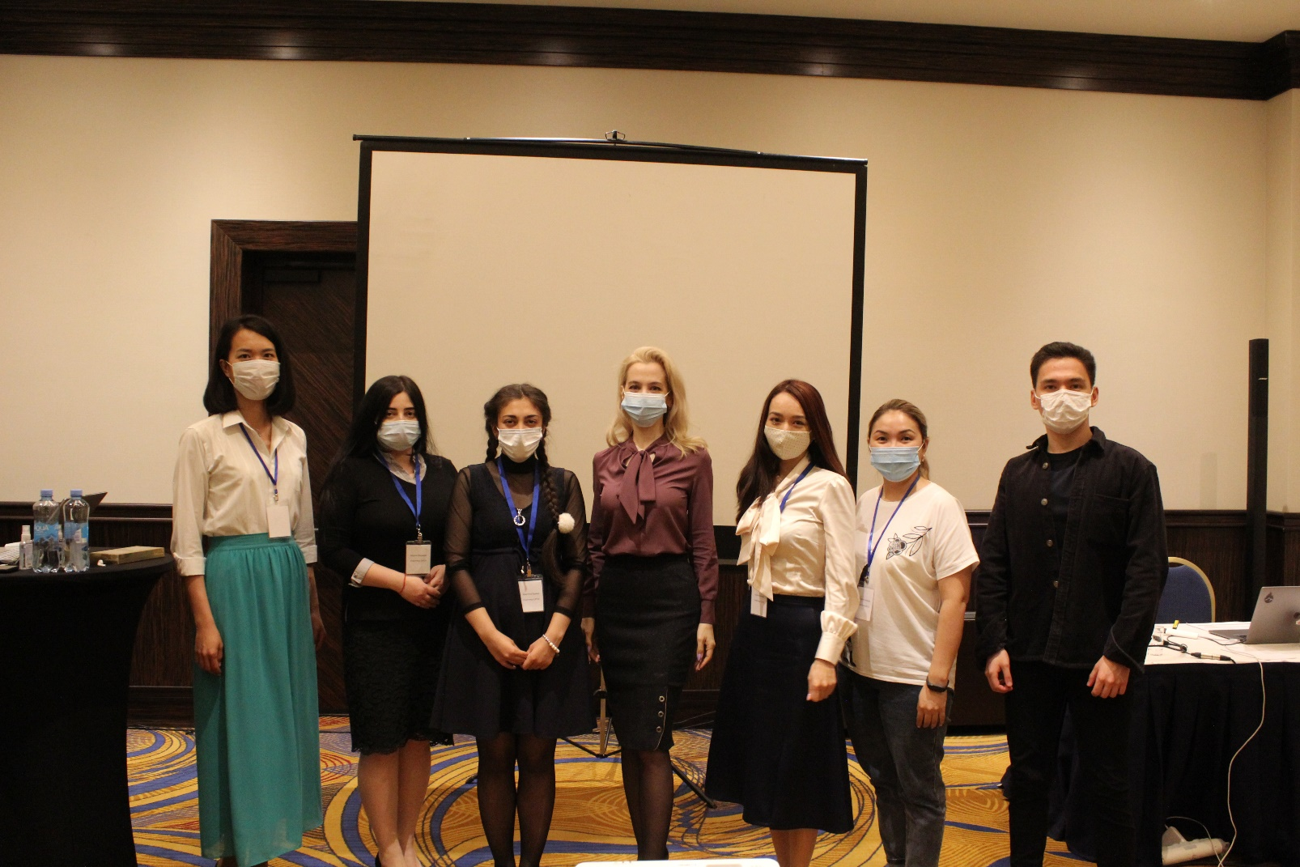
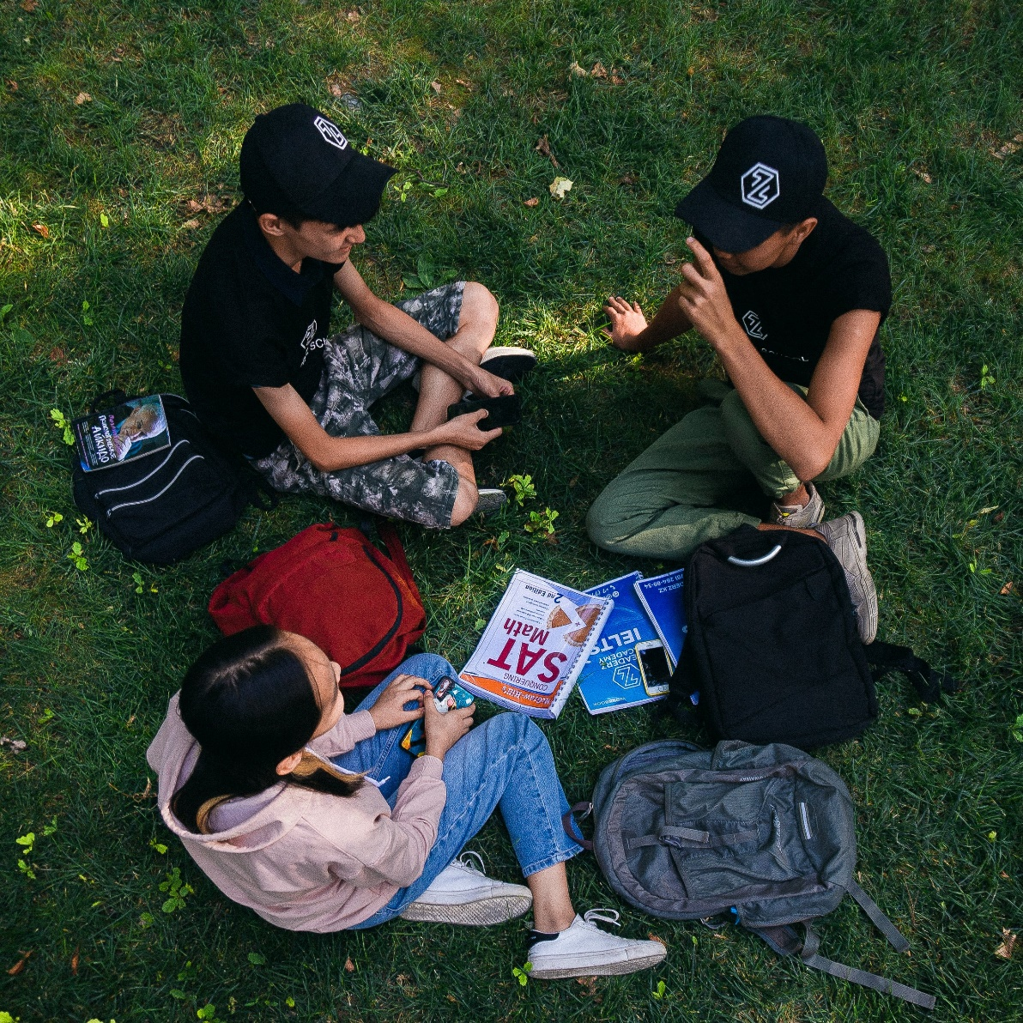
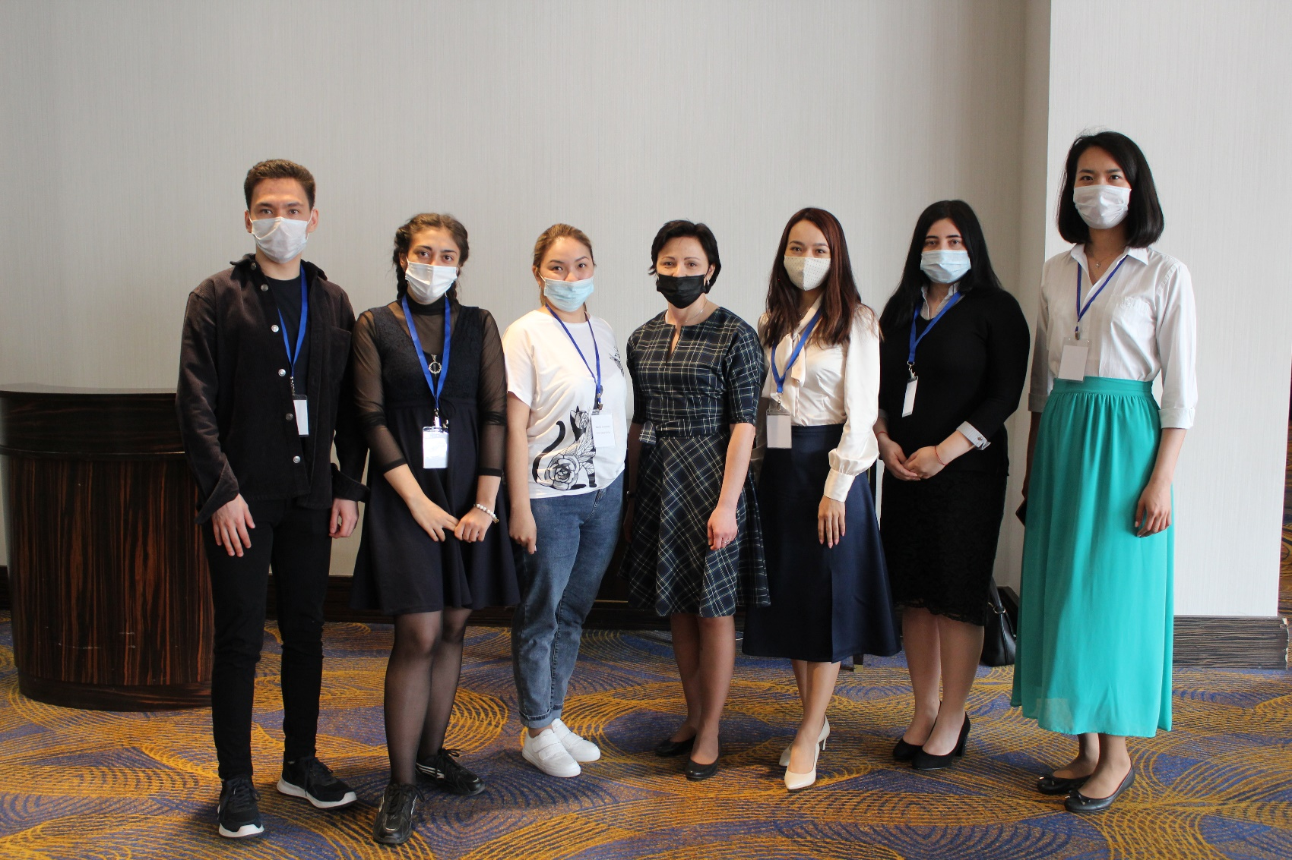


Slide 8

Any questions?
Call +7 (778) 284-89-34 or write us leaderz.kz@gmail.com

