Slide 1
International partnership network of law companies
Customs&CorporateLawyers

Slide 2
ABOUT THE PROJECT
International partnership of law companies Customs & Corporate Lawyers, based on the principles of observance of high professional standards and commitment to the interests of our clients - is a partnership network of highly professional law companies from Eurasian countries as well as a number of countries, their traditional foreign trade partners.
As it is known, only professionalism, long-term and successful experience of work, as well as an extensive practice allow lawyers to solve effectively the issues and problems, encountered by investors, foreign companies and foreign representative offices, companies-participants of foreign trade activities, as well as national companies, conducting business abroad.
However, as experience shows, it is becoming more and more important to have an opportunity to provide clients with high quality services in support businesses outside national jurisdiction.
The reality is that the law companies become more important and are able to offer its clients high-quality services to support of projects beyond their national jurisdictions, especially, in the wider limits of their economic regions.

Slide 3
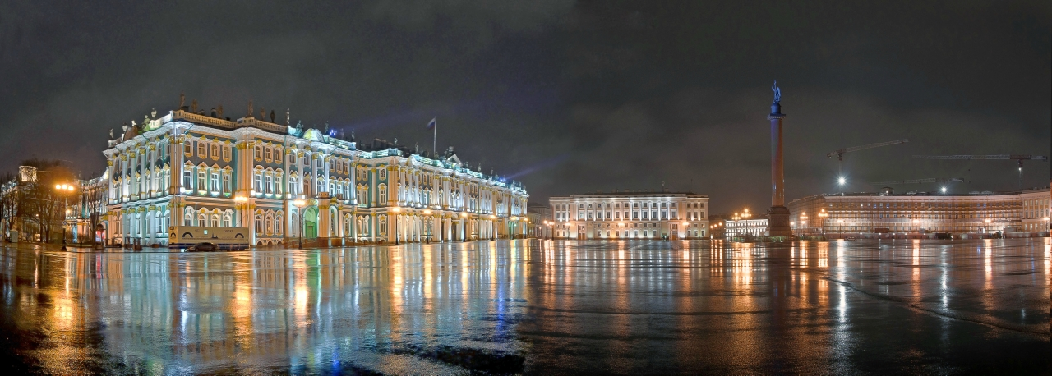
ABOUT THE PROJECT
Taking into account the foregoing realities of the modern world, for this project a big association of professional law companies was created, which is able to implement large and complicated projects, and to support the important private interests of clients.
The necessary quality of legal assistance of the participating companies of the Customs & Corporate Lawyers provided by certain basic standards (by the way, one of the most demanding), including ethical, which were established for lawyers, offering legal services to clients.
As a result, the participants of Customs & Corporate Lawyers can not only exchange services and clients, but also use universal base standards of clients relationship, disciplinary and clear pricing policy, that has not only strengthen reputation of companies of network, but actually created new services and guarantees for clients.

Slide 4
Why is IT BENEFICIAL FOR our CLIENTS?
Clients of any companies of network Customs & Corporate Lawyers have the opportunity to get outside of their home country legal or consulting services, conforming to the highest quality standards. You need just to contact a company in your country, having a logotype on this emblem:
So, for example, a client from New York, if it is necessary, can quickly and efficiently get quality legal services in Russia (or in any other country or region of the planet, where there is another company of the network) without even leaving his country.
It gets special practical sense, if we consider, that professional network of law companies Customs & Corporate Lawyers allows to execute tasks set by the client, operational, with all the nuances of local and international legislation and law enforcement practice.

Slide 5
TRADEMARK/ SERVICE MARK
Partnership network Customs & Corporate Lawyers is the owner of the exclusive right to use this service mark, registered in the countries of the European Union, North America, CIS and number of other countries, as well as the owner of the corresponding commercial name as a means of individualization.
That allows to offer highly qualified legal services all around the world under a single brand, protected by international and national legislations, providing additional guarantees to our clients in the reliability and quality of legal services.

Slide 6
KEY PRACTICES OF COMPANIES OF
CUSTOMS & CORPORATE LAWYERS:
legal support of investment projects
tax law and tax disputes
corporate practice
commercial/M&A practice
antimonopoly regulation
land law, real estate and construction practice
practice on commercial dispute resolution
intellectual property
banking practice
customs law and foreign trade regulation
administrative - legal support of business and criminal-juridical protection of business

Slide 7
our professionals are in demand and represented in :
Customs Policy Council of the Chamber of Commerce and Industry of the Russian Federation
International Commercial Arbitration Court at the CCI of Russia
Maritime Arbitration Commission at the Russian Chamber of Commerce and Industry
Public Council under the Federal Accreditation Service of Russia
London International Court of Arbitration
Kazakhstan International Arbitration
Kuala Lumpur Regional Arbitration Center
German Institute of Arbitration
Asian and Pacific Lawyers Association
Business Council for Cooperation with Switzerland
Business Council for Cooperation with Croatia

Slide 8
Our approach is :
CUSTOMER FOCUS we provide services in accordance with the needs and expectations of all clients are in interested jurisdictions
FLEXIBILITY
we are closely cooperating with the companies-partners around the world in integrated teams, providing integrated services («without seam»)
CONFIDENTIALITY the circumstances and information which have been entrusted to us by the client in connection with our professional activity shall not be disclosed under any circumstances.

Slide 9
OUR PRIORITIES :
Service quality, responsibility, efficiency, individual approach and complex legal support
OUR MAIN VALUE :
Our employees. Our lawyers and attorneys, recognized experts in their field of law. We constantly expand our services in order to provide our clients calm and confident business development
OUR MAIN ACHIEVEMENT :
Clients satisfied with the result of our work.
We strongly believe in a long-term cooperation based on understanding and mutual success. Every client is valuable for us, whether developing a Russian company or international corporations

Slide 10
Head office:
Rozhdestvensky Boulevard 9 , Moscow, Russia, 107045
Customs&CorporateLawyers
+7 (495) 410-21-83, +7 (985) 4114306,
e-mail: customs@customs.su
Website: www.accl.ru
CONTACTS

